Slide 1
Autistic Spectrum Disorder Screening For Children
PROJECT MEMBERS
Ananthu S Kuttattu AM.EN.U4CSE15109
Anu P Nair AM.EN.U4CSE15110
Gokul G S AM.EN.U4CSE15125
K Ananthakrishnan AM.EN.U4CSE15130

Slide 2
PROBLEM DEFINITION
To develop prediction model Autistic Spectrum Disorder (ASD) in children which involves Data Mining Techniques.And to understand and clearly describe the problem that is being solved. It determines and built a predictive model for predicting the ASD in children.

Slide 3
PROBLEM DESCRIPTION
⦁ Autistic Spectrum Disorder (ASD). ASD is a mental disorder that limits the use of linguistic, communicative, cognitive, skills as well as social skills and abilities.
⦁ Machine learning considers the ASD diagnosis problem as a classification task in which predictive models are built based on historical cases and controls.

Slide 4
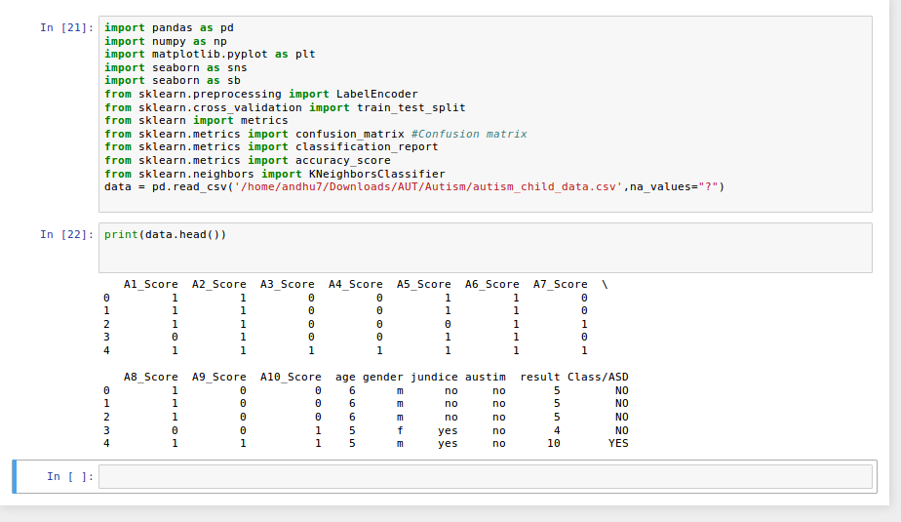
DATA SET
Here we are using three different data set .
Dataset 1 Autism-child-data
Number of Instances: 292
Number of Attributes:15
Number of classes: 2

Slide 5
Attributes
1. A1_Score
2. A2_Score
3. A3_Score
4. A4_Score
5. A5_Score
6. A6_Score
7. A7_Score
8. A8_Score
9. A9_Score
10. A10_Score
11. age
12. gender- [m,f]
13. jundice – [yes,no]
14. austim – [yes,no]
15. result – [class/ADS]

Slide 6
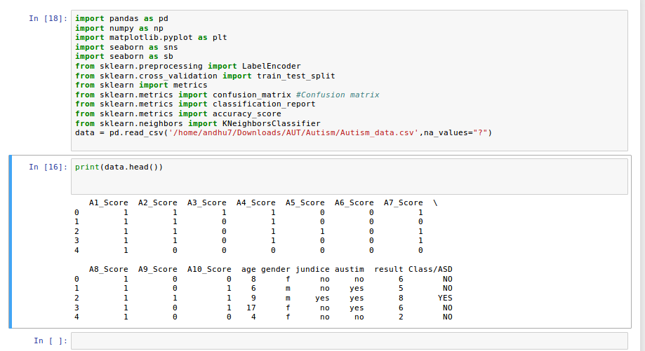
Dataset 2 Autism-Data
Number of Instances: 704
Number of Attributes: 15

Slide 7
Attributes
1. A1_Score
2. A2_Score
3. A3_Score
4. A4_Score
5. A5_Score
6. A6_Score
7. A7_Score
8. A8_Score
9. A9_Score
10. A10_Score
11. age
12. gender- [m,f]
13. jundice – [yes,no]
14. austim – [yes,no]
15. result – [class/ADS]

Slide 8
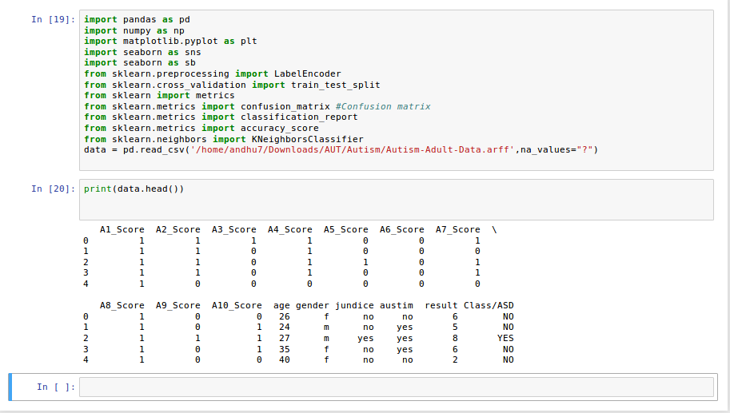
Dataset 3 – Autism-Adult-Data
Number of Instances: 480
Number of Attributes: 15

Slide 9
Attributes
1. A1_Score
2. A2_Score
3. A3_Score
4. A4_Score
5. A5_Score
6. A6_Score
7. A7_Score
8. A8_Score
9. A9_Score
10. A10_Score
11. age
12. gender- [m,f]
13. jundice – [yes,no]
14. austim – [yes,no]
15. result – [class/ADS]

Slide 10
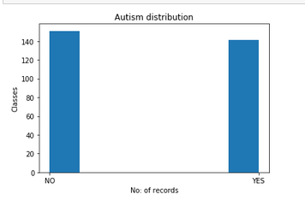
DATA VISUALIZATION
No.of records of class ‘Yes’ - 151
No.of records of class ‘No’- 141
From the graph, we can interpret that records having label as ‘Yes is greater than records having label as‘No’.
Dataset 1

Slide 11
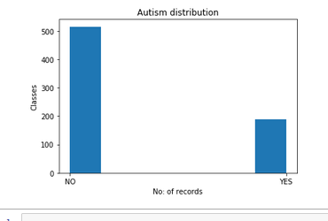
No.of records of class ‘Yes’ -515
No.of records of class ‘No’- 189
From the graph, we can interpret that records having label as ‘Yes’ is greater than records having label as ‘No’.
Dataset 2

Slide 12
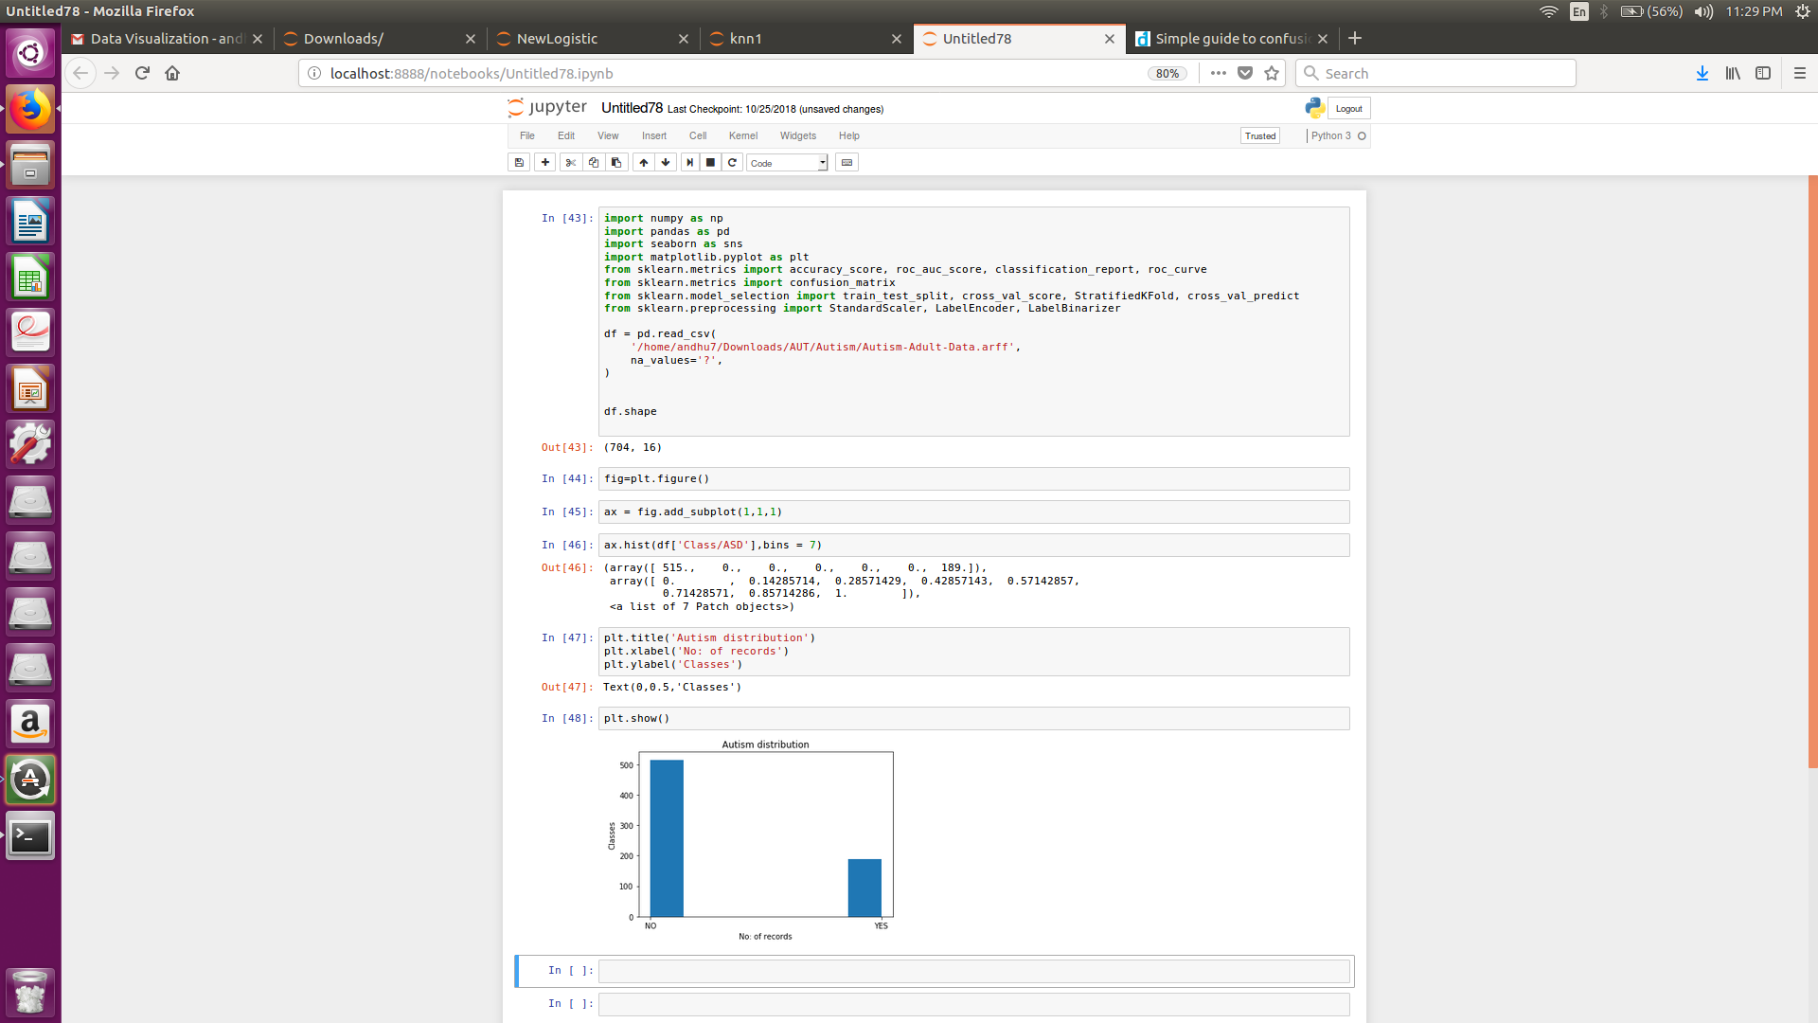
No.of records of class ‘Yes’ - 515
No.of records of class ‘No’- 189
From the graph, we can interpret that records having label as ‘Yes’ is greater than records having label as ‘No’.
Dataset 3

Slide 13
PREPROCESSING STEPS
The Multi Values of an attribute will be converted to separate attributes with binary values.
All yes or no values will be converted to binary values(“yes”- 1, “no” - 0).
The null values will be changed to required mean values

Slide 14
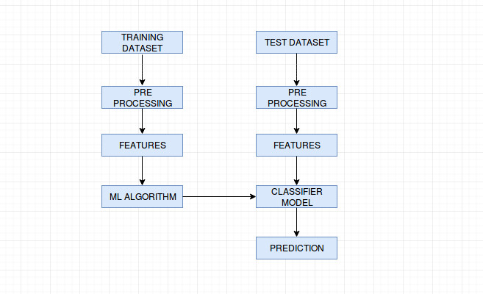
SOLUTION APPROACH

Slide 15
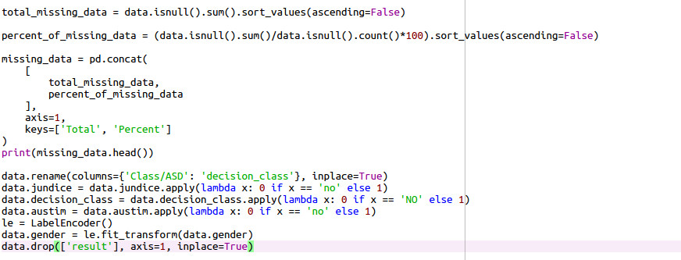

Slide 16
SUPERVISED LEARNING ALGORITHM
We are solving this problem using three different machine learning algorithms
KNN
K-Nearest Neighbors is one of the most basic yet essential classification algorithms in Machine Learning. It belongs to the supervised learning domain and finds intense application in pattern recognition, data mining and intrusion detection.
K nearest neighbors is a simple algorithm that stores all available cases and classifies new cases based on a similarity measure (e.g., distance functions). KNN can be used for classification .

Slide 17
Logistic regression
Logistic regression is the appropriate regression analysis to conduct when the dependent variable is dichotomous (binary). Like all regression analyses, the logistic regression is a predictive analysis. Logistic regression is used to describe data and to explain the relationship between one dependent binary variable and one or more nominal, ordinal, interval or ratio-level independent variables.

Slide 18
Decision tree
Decision tree is a type of supervised learning algorithm (having a pre-defined target variable) that is mostly used in classification problems. It works for both categorical and continuous input and output variables. In this technique, we split the population or sample into two or more homogeneous sets (or sub-populations) based on most significant splitter / differentiator in input variables.

Slide 19
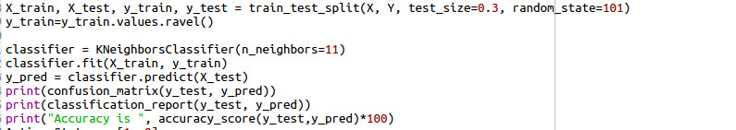
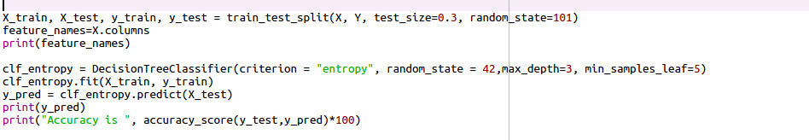
CODE
KNN
Decision tree

Slide 20
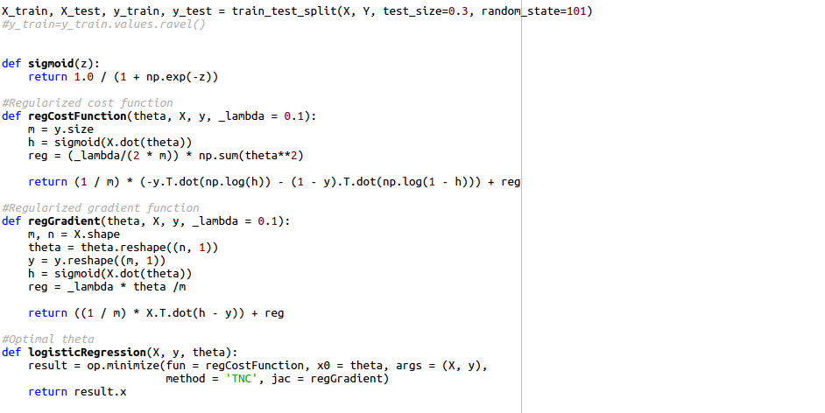
Logistic Regression

Slide 21
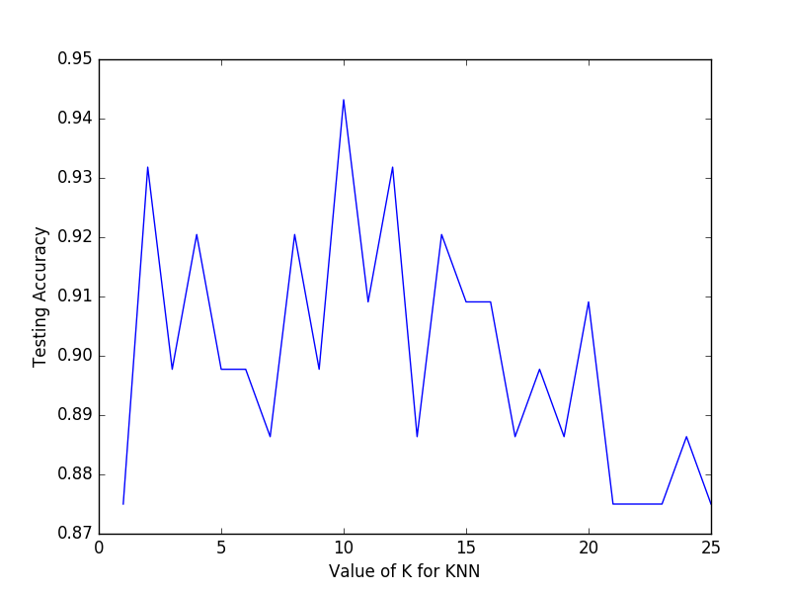
VI. KNN line plots for different datasets
DATASET 1
Maximum accuracy=94.318181818182%
K value 10

Slide 22
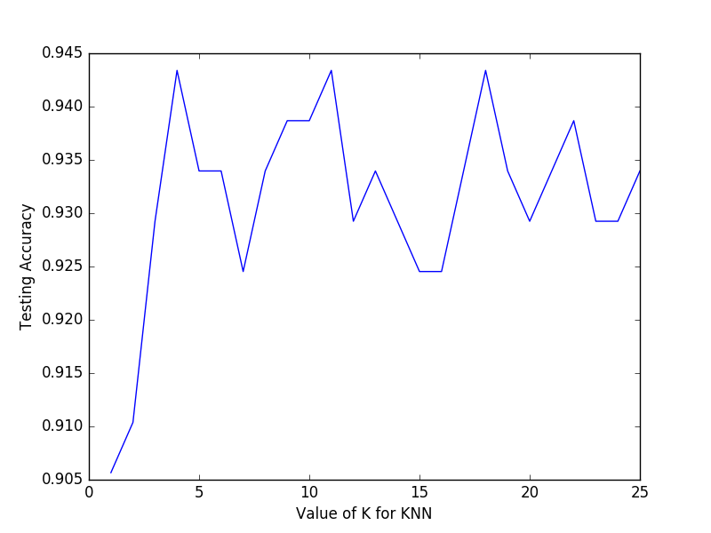
DATASET 2
Maximum accuracy = 94.3396226415%
K value= 11

Slide 23
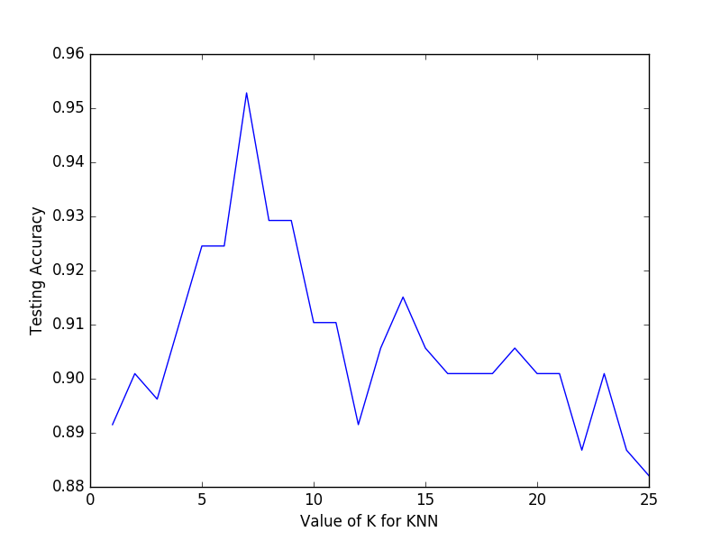
DATASET 3
Maximum accuracy=95.2830188679%
K value= 7

Slide 24
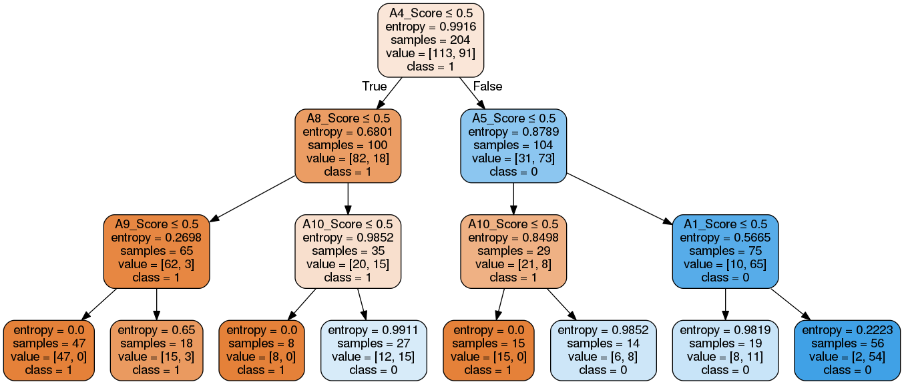
Decision tree for different Datasets
Dataset 1

Slide 25
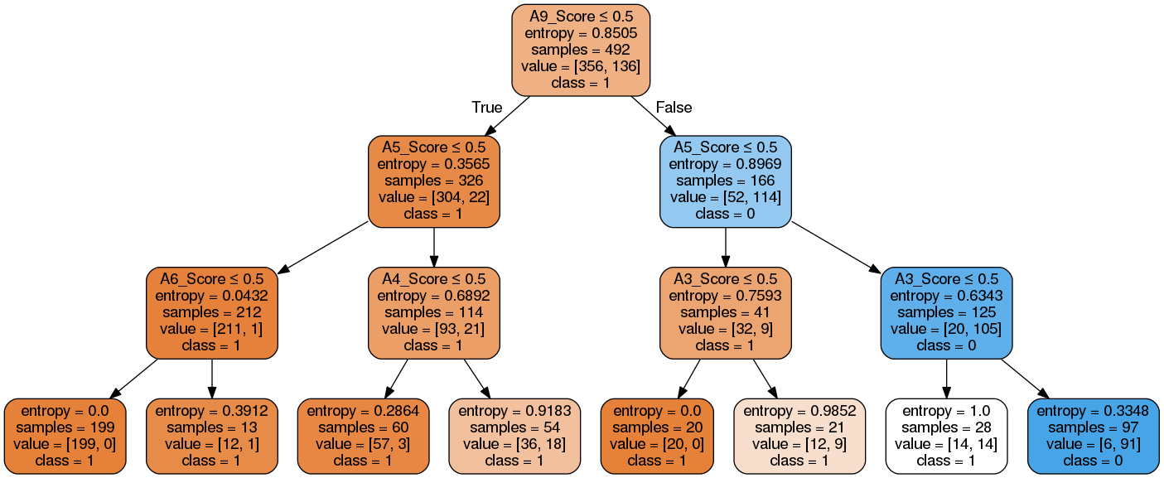
Dataset 2

Slide 26
Dataset 3

Slide 27
Algorithm for completely implemented code
https://drive.google.com/drive/folders/1-0sSv4QltItGGR7NtFXxLqNnK2ANPI_l?usp=sharing

Slide 28
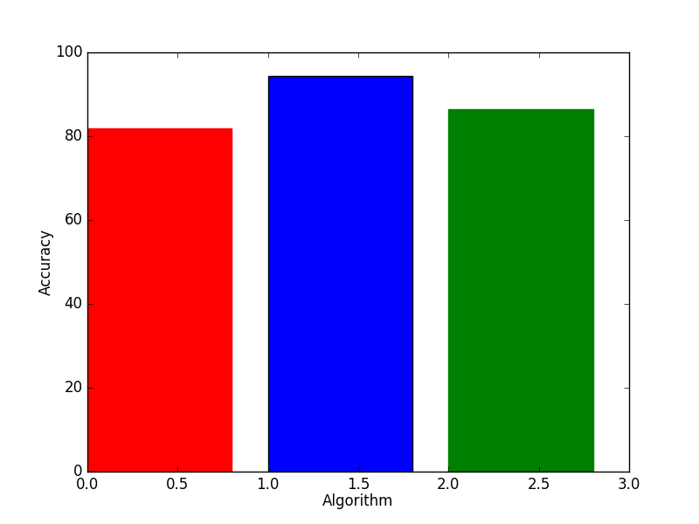
RESULTS
Comparison of different algorithms on each dataset
Accuracy obtained using KNN(blue)=94.3181%
Accuracy obtained using Decision tree(red)=81.818%
Accuracy obtained using Logistic regression(green)=86.363 %
Therefore, it can be concluded that for dataset 1, KNN works better than other algorithms.

Slide 29
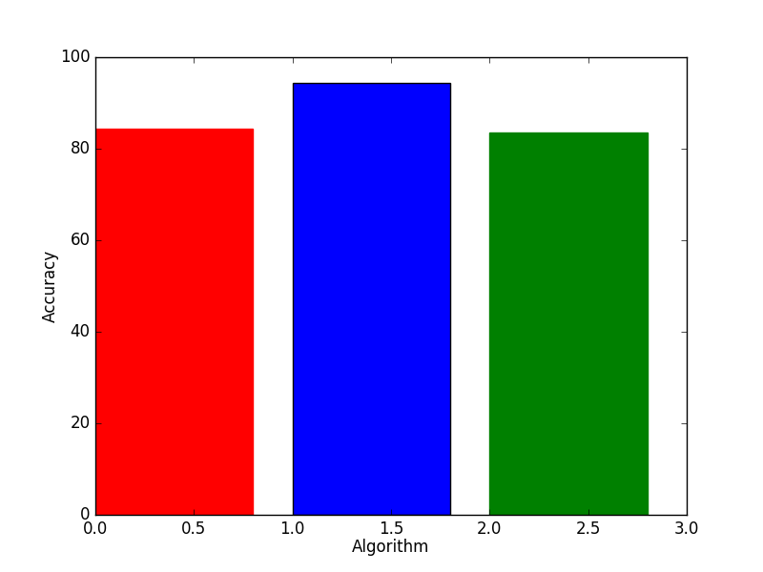
comparison of different algorithms on dataset 2
Accuracy obtained using KNN(blue)=94.3396%
Accuracy obtained using Decision tree(red)=84.433%
Accuracy obtained using Logistic Regression(green)=83.490%
Therefore, it can be concluded that for dataset 2, KNN works better than other algorithms.

Slide 30
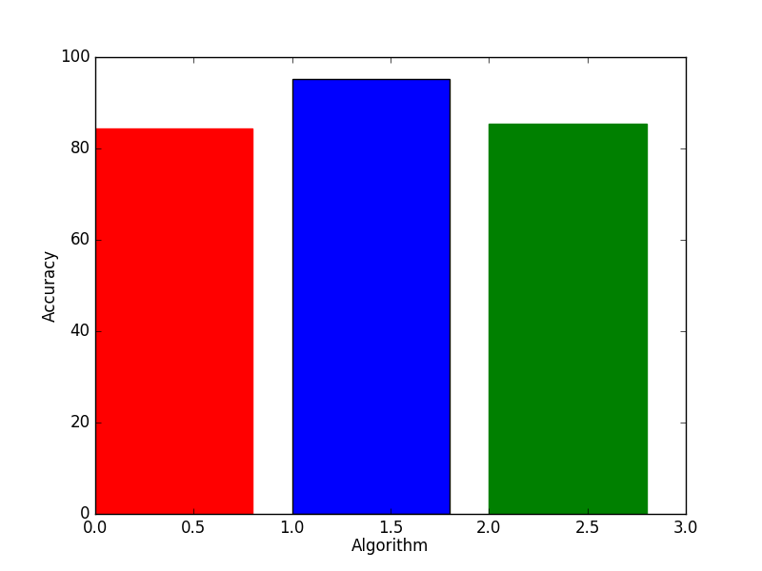
comparison of different algorithms on dataset 3
Accuracy obtained using KNN(blue)=95.28301%
Accuracy obtained using Decision tree(red)=84.433%
Accuracy obtained using Logistic Regression(green)=85.377%
Therefore, it can be concluded that for dataset 1, KNN works better than other algorithms.

Slide 31
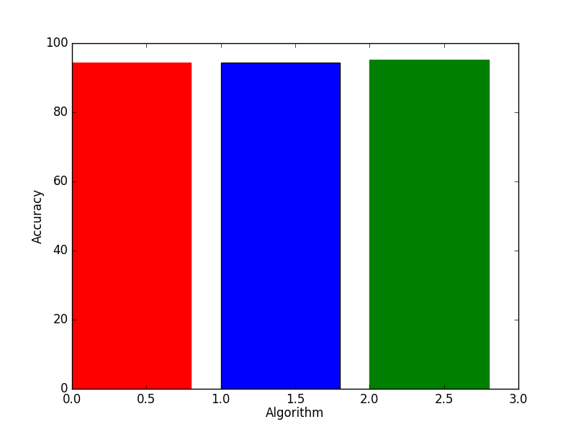
II. Comparison of different datasets on each algorithm
Accuracy obtained from dataset 1(red)=94.3181 %
Accuracy obtained from dataset 2(blue)=94.3396%
Accuracy obtained from dataset 3(green)=95.28301%
Therefore, it can be concluded that KNN works better for Dataset 3 compared to other datasets.
comparison of different dataset using KNN

Slide 32
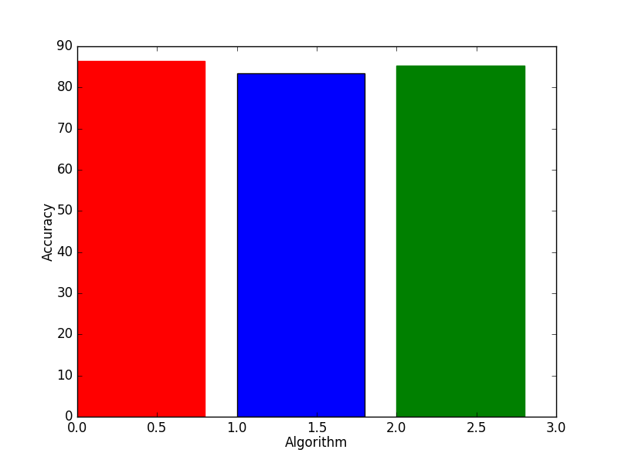
Accuracy obtained from dataset 1(red)= 86.363 %
Accuracy obtained from dataset 2(blue)=83.490%
Accuracy obtained from dataset 3(green)=85.377%
Therefore, it can be concluded that Logistic regression works better for Dataset 1 compared to other datasets.
comparison of different dataset using Logistic regression

Slide 33
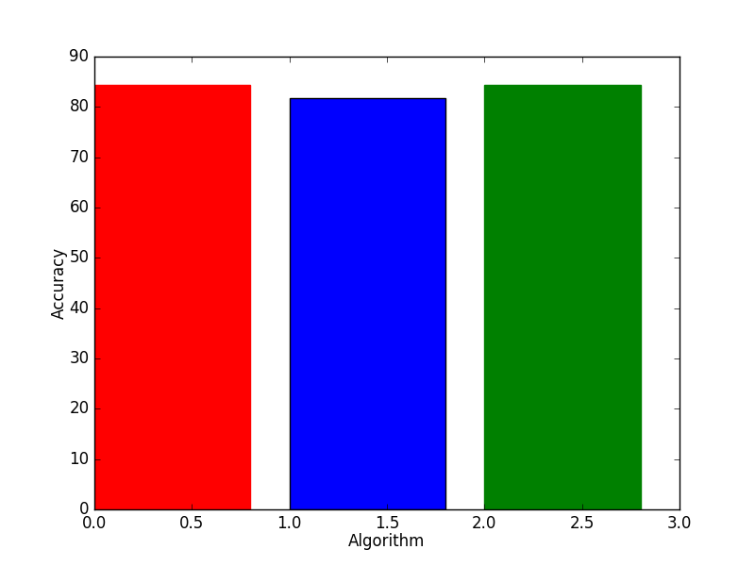
Accuracy obtained from dataset 1(red)= 81.818 %
Accuracy obtained from dataset 2(blue)= 84.433 %
Accuracy obtained from dataset 3(green)= 84.433 %
Therefore, it can be concluded that Decision tree works better for Dataset 2 and 3 compared to other dataset.
comparison of different dataset using Decision tree

Slide 34
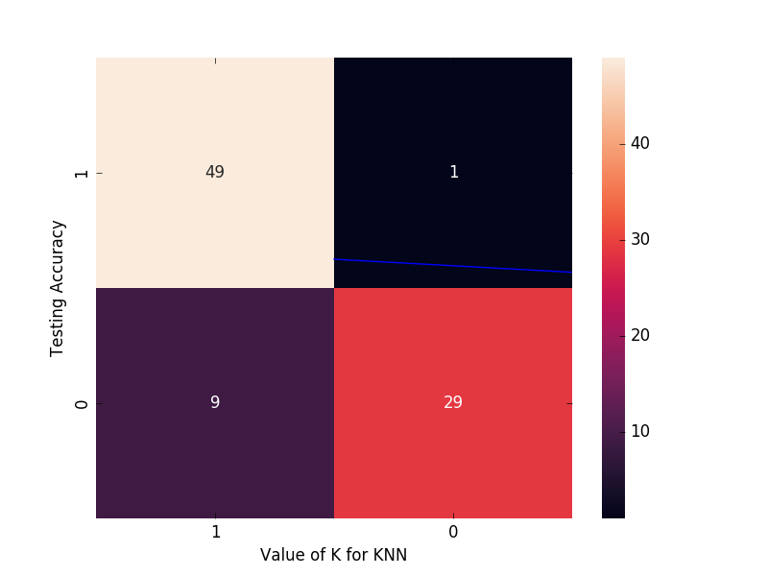
III. KNN confusion matrices for different datasets
DATASET 1
Accuracy = 89.7727272727
Precision = 0.9
Recall = 0.98

Slide 35
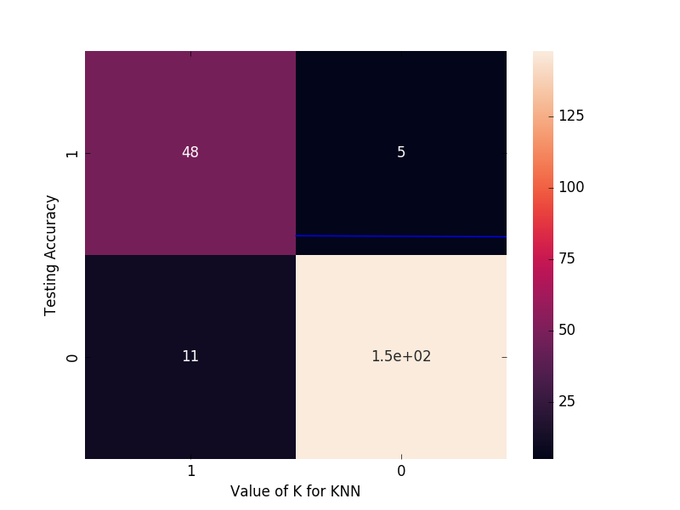
DATASET 2
Accuracy = 93.3962264151
Precision = 0.94
Recall = 0.93

Slide 36
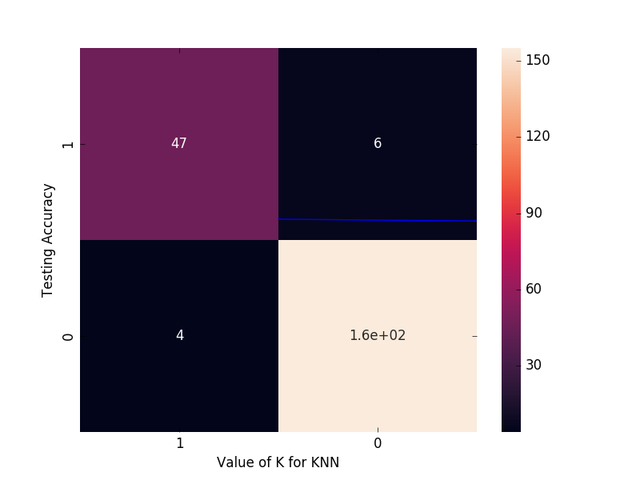
DATASET 3
Accuracy = 92.45283018
Precision = 0.93
Recall = 0.92

Slide 37
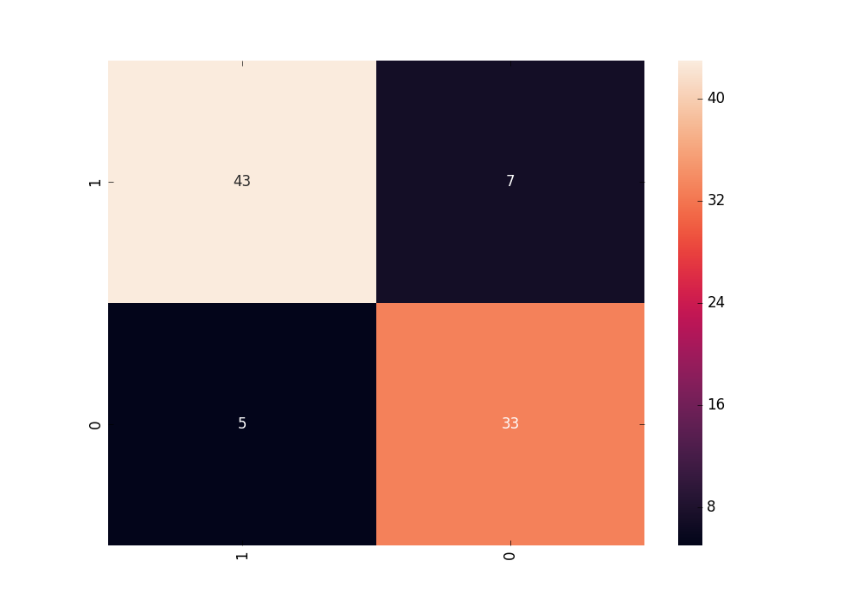
IV. Logistic Regression confusion matrices for different datasets
DATASET 1
Accuracy = 86.36363636
Precision = 0.87
Recall = 0.86

Slide 38
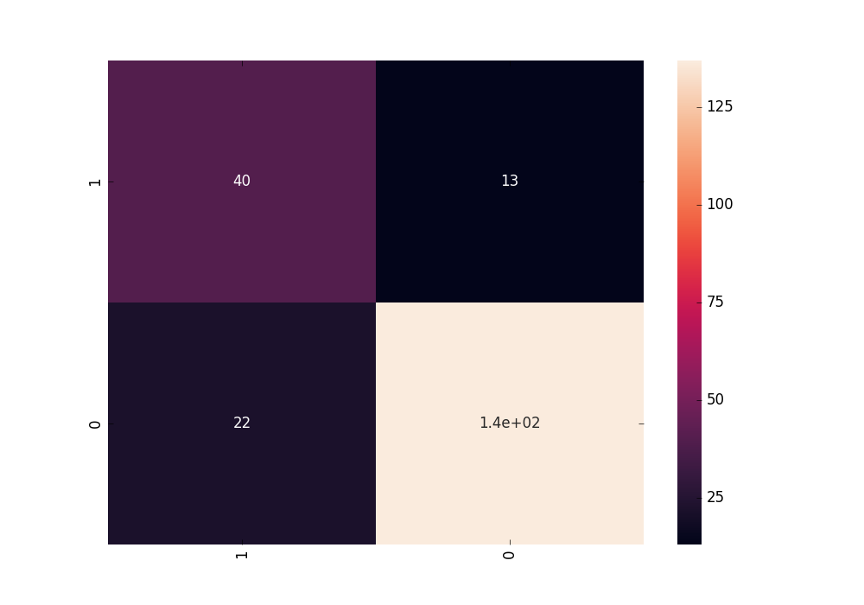
DATASET 2
Accuracy = 83.49056603
Precision = 0.85
Recall = 0.83

Slide 39
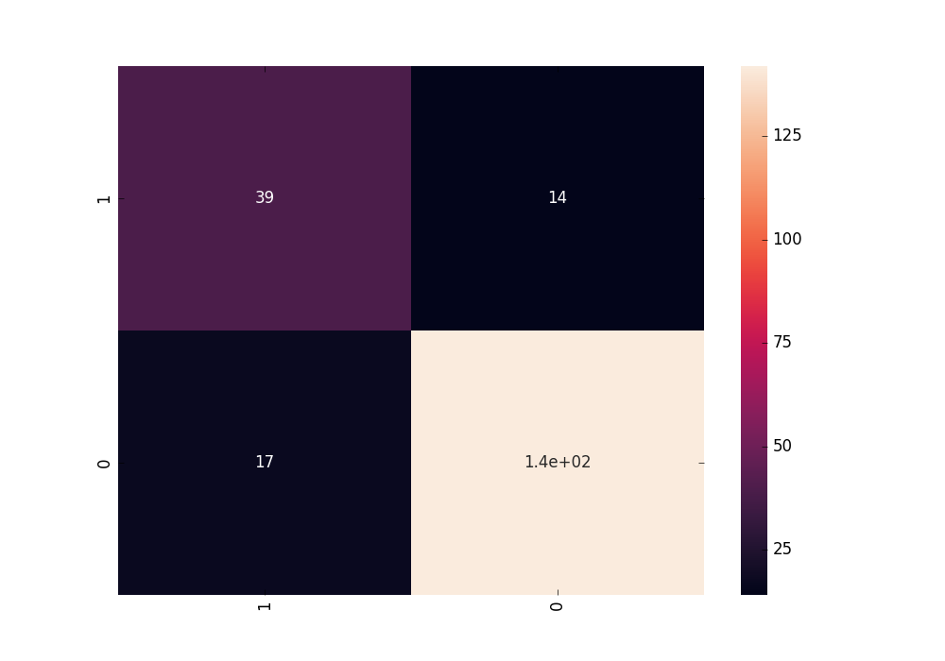
DATASET 3
Accuracy = 85.37735849
Precision = 0.86
Recall = 0.85

Slide 40
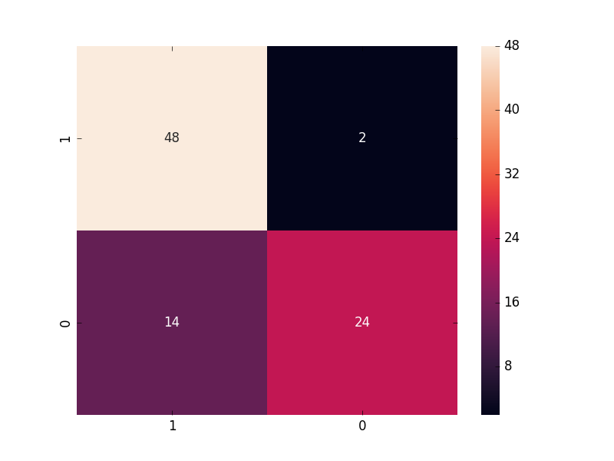
V. Decision tree confusion matrices for different datasets
DATASET 1
Accuracy = 81.8181818182
Precision = 0.84
Recall =0.82

Slide 41
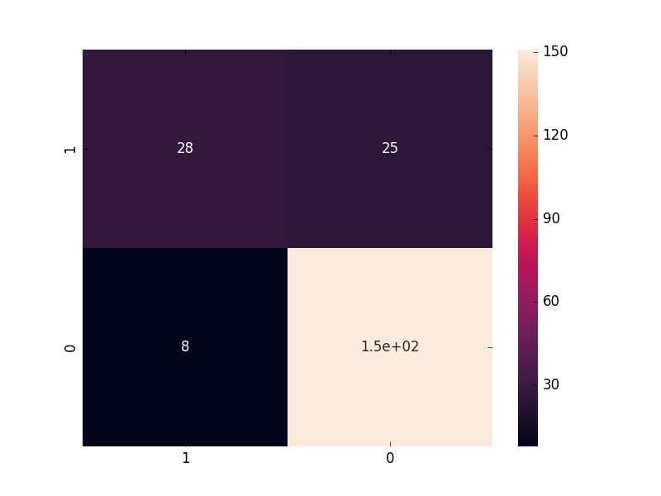
DATASET 2
Accuracy = 84.43396226
Precision = 0.94
Recall =0.94

Slide 42
DATASET 3
Accuracy = 84.43396226
Precision = 0.84
Recall =0.84

Slide 43
THANK YOU

